Slide 1
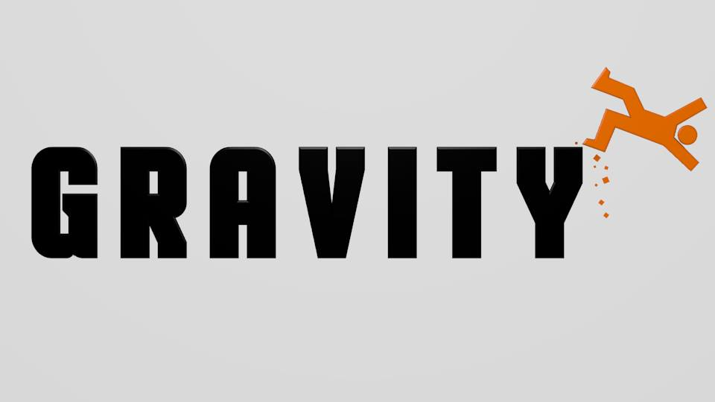
Team Gravity
NCT Management System

Slide 2
Team Members
Brian Briscoe
Team Leader, Planner, Documenter
Jasper Hou
Tester, Designer
Mateusz Pietraszewski
Coder, Designer

Slide 3
Communication
Facebook
Group Meetings

Slide 4
NCT Management System
Desktop Application/Website (TBC)
Android Application
Shared Database

Slide 5
USP's
Remote Database – RaspberryPi/Cloud Virtual Machine
Purpose-built Android application
Cost benefits (paper)

Slide 6
Why are we best suited?
Experienced in project skills
Databases
Android Applications
Desktop Applications

Slide 7
Alternate Projects
Surgery Appointment Management System
Hotel Booking System

